Slide 1
Digital Portfolio
Thilaga
STUDENT NAME:
REGISTER NO AND NMID: 32124U18072&
DEPARTMENT: Bsc.Computer Science
COLLEGE: COLLEGE/ UNIVERSITY Muthurangam Government
Arts College (A)-vellore /Thiruvalluvar university
1E9CA4C1AA13CCB89AF4A67DB486A03C

Slide 2
PROJECT TITLE
Indian foods
Portfolio

Slide 3


AGENDA
Problem Statement
Project Overview
End Users
Tools and Technologies
Portfolio design and Layout
Features and Functionality
Results and Screenshots
Conclusion
Github Link
3/21/2024 Annual Review

Slide 4

PROBLEM STATEMENT
The given code is a personal digital portfolio webpage for a user named Thilaga, showcasing:
Introduction (Home section)
About Thilaga & Indian Food
Skills (HTML, CSS, JS, Python)
Design a personal digital portfolio for a
Computer Science student that showcases their skills, projects, and interests—including a themed menu section on Indian food—with responsive design, interactive filtering, and a contact form for user engagement.

Slide 5

PROJECT OVERVIEW
This is a personal digital portfolio website created by Thilaga, a BSc Computer Science student. It showcases her skills in web development, introduces Indian cuisine, and includes the following key sections:
Home: Welcome message and navigation.
About Me: Brief intro about Thilaga and her interest in tech.
Skills: Highlights her proficiency in HTML, CSS, JavaScript, and Python.
Menu (Projects): Interactive gallery of Indian food items with filter options for vegetarian and non-vegetarian dishes.
Contact: A form to get in touch, with user-friendly feedback.

Slide 6

WHO ARE THE END USERS?
👉 Potential employers, recruiters, or clients interested in the creator's skills in web development and data analytics.
👉 Visitors or food enthusiasts who want to explore Indian cuisine.
👉 Friends, mentors, or teachers evaluating Thilaga’s academic or project work.

Slide 7

TOOLS AND TECHNIQUES
🔧 Tools:
HTML – Structure of the webpage.
CSS – Styling and layout (with custom fonts and gradients).
JavaScript – Interactivity (filter menu items, form handling).
Fonts – Poppins, Lobster (for aesthetic typography).
Images – From Pexels (used in the food cards).

Slide 8
Responsive Design – Uses viewport, grid, and flexible layouts.
Component-Based Layout – Sections like About, Skills, Menu, Contact.
CSS Transitions – Smooth hover and filter animations.
Event Handling – JavaScript onclick for filtering and submit for form alert.
Semantic HTML – Proper use of <section>, <header>, <footer>, etc.
Let me know if you want this info as a slide or bullet format in a document!
🛠️ Techniques:

Slide 9
POTFOLIO DESIGN AND LAYOUT
🎨 Theme: Clean, modern, and vibrant design with a purple color palette.
🏠 Sections:
Header: Intro + navigation + “Explore” button.
About: Info about you and Indian food.
Skills: Skill list with star ratings.
Menu/Projects: Cards for dishes (veg/non-veg) with image, title, and description + filter buttons.
Contact: Simple form + email info.
Footer: Copyright.
9

Slide 10
FEATURES AND FUNCTIONALITY
Responsive Layout: Mobile-friendly design using HTML & CSS.
Navigation Menu: Smooth in-page navigation (Home, About, Menu, Contact).
About Section: Info about the portfolio owner and Indian food culture.
Skills Section: Visual skill ratings using star icons.
Menu Section:
Food items displayed in a card grid.
Filter Buttons to show: All / Veg / Non-Veg items.
Contact Form:
Collects Name, Email, Message.
Shows alert on submit instead of sending (demo mode).

Slide 11
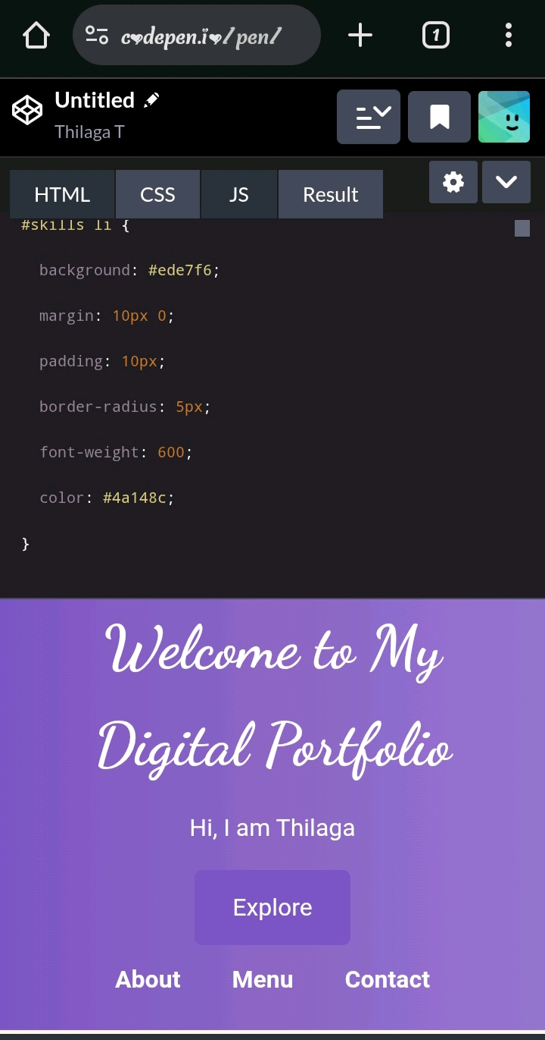
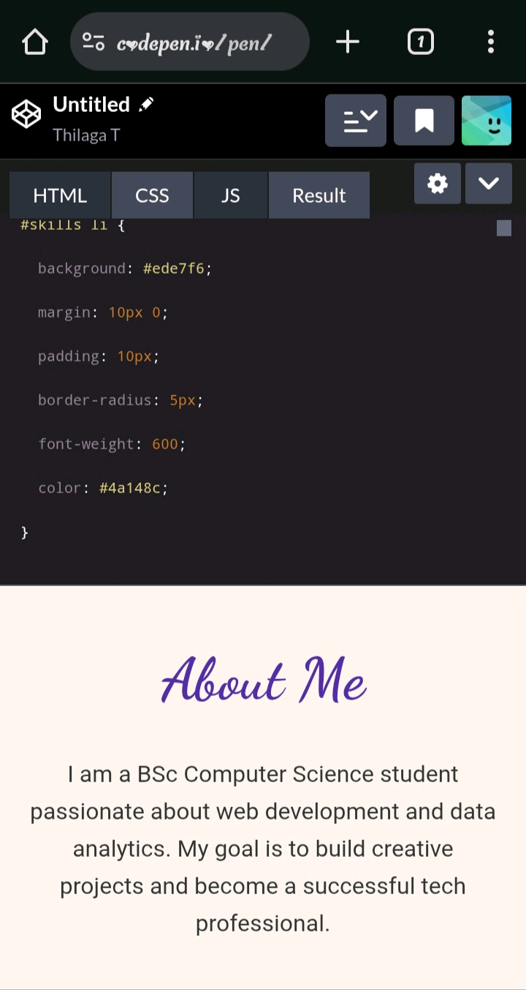
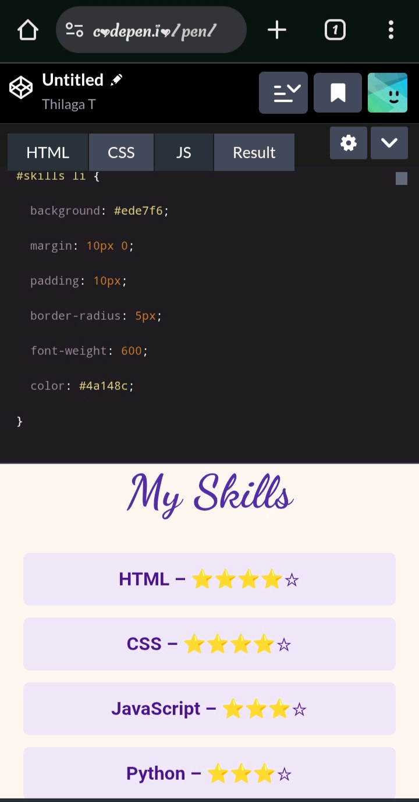

RESULTS AND SCREENSHOTS
3/21/2024 Annual Review
11

Slide 12
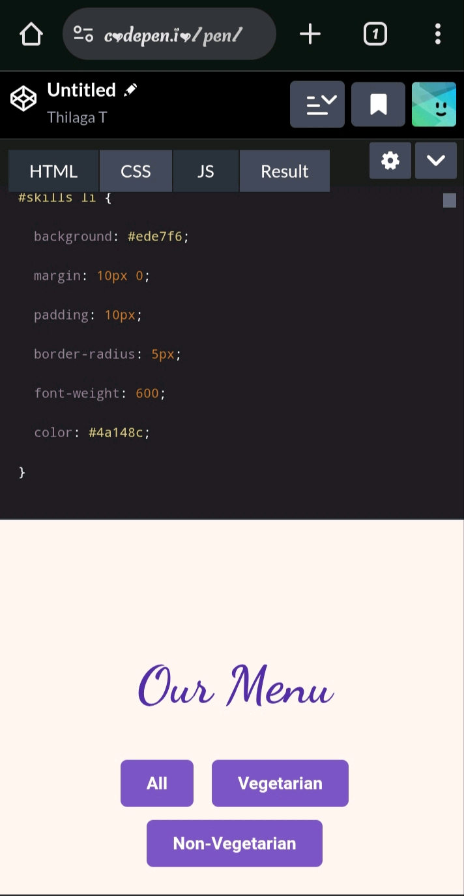
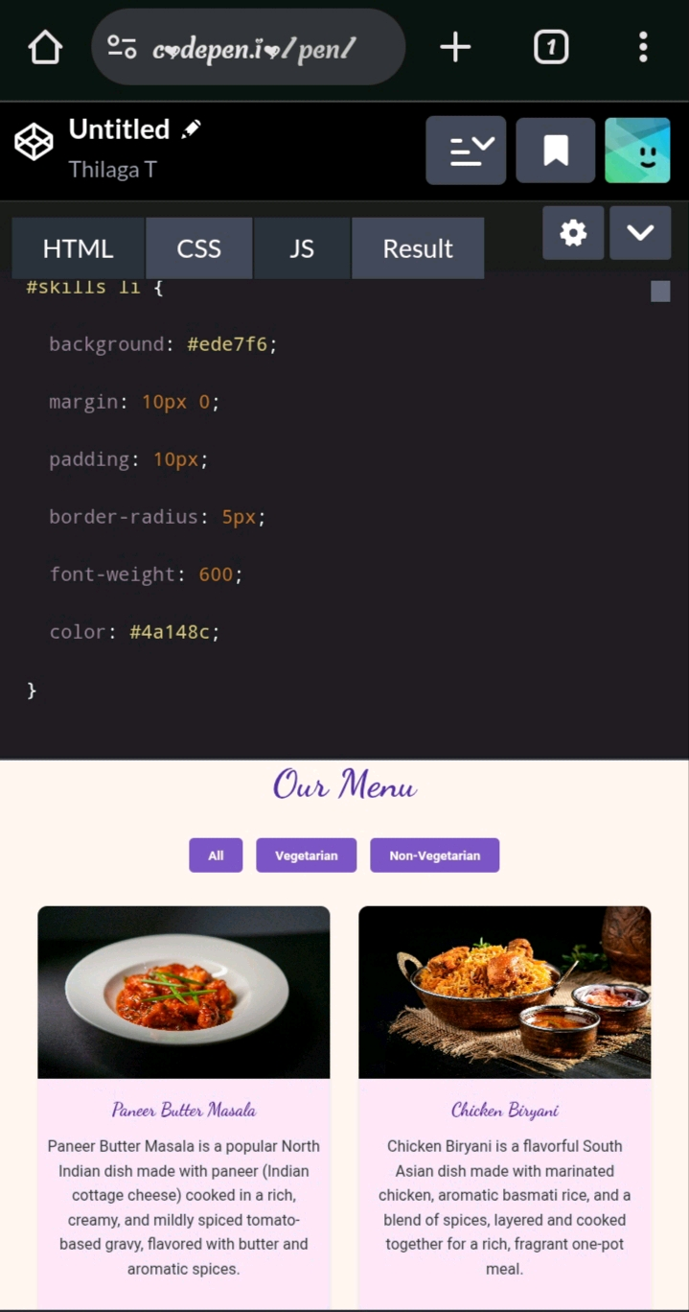
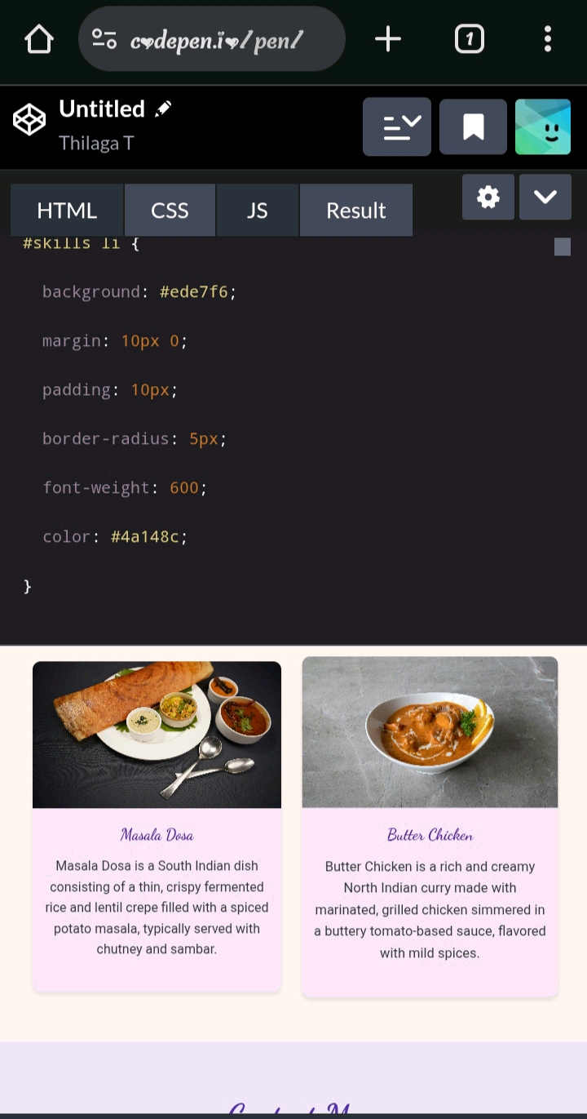
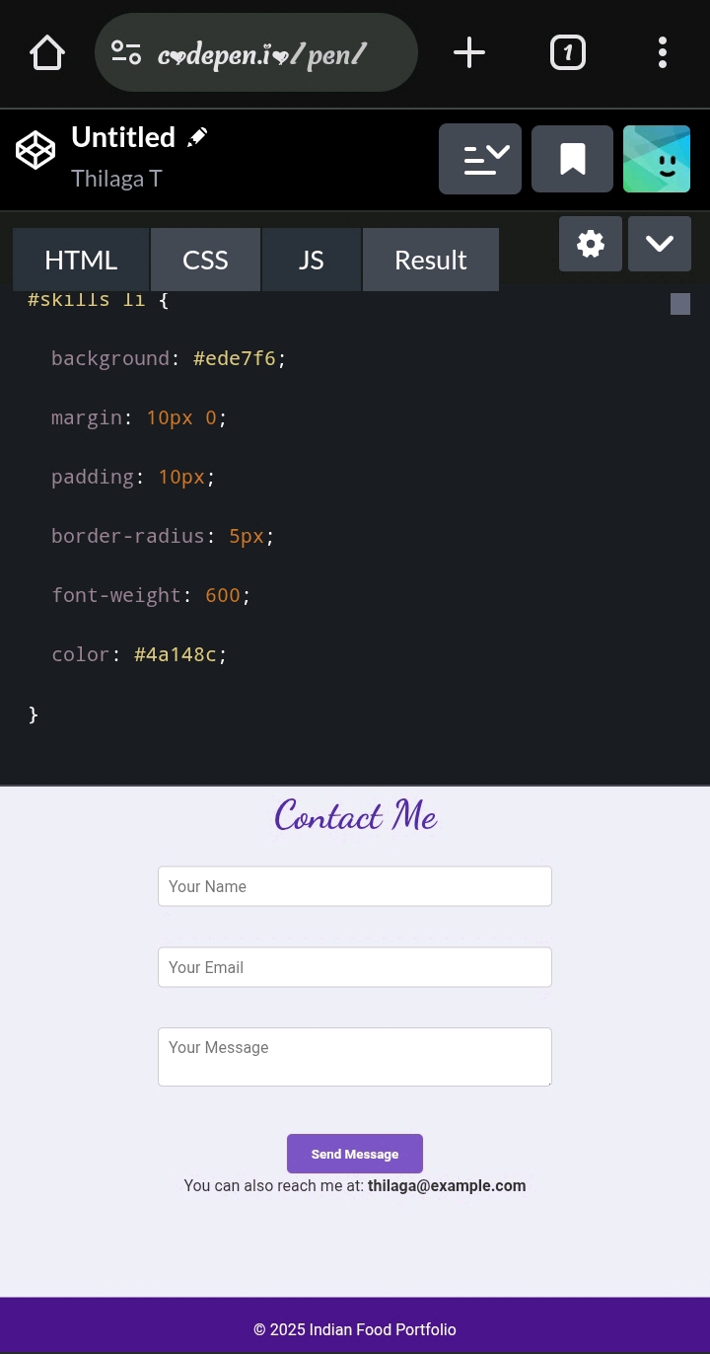

Slide 13
CONCLUSION
Your code creates a clean, visually appealing digital portfolio webpage featuring sections for About, Skills, Menu (with a filterable food menu), and Contact. It uses modern HTML, CSS for styling with purple-themed colors, and JavaScript to filter menu items and handle contact form submission smoothly.
Overall, it’s a well-structured, user-friendly portfolio focused on Indian cuisine and your web development skills
13

